Slide 1
Module 1: An Overview of United Nations Peacekeeping Operations
Lesson
1. 4
Legal Framework for
United Nations Peacekeeping

Slide 2
Relevance
Peacekeeping personnel:
“Ambassadors” of the UN
Role models, a good example
Know what you “should” and “should not” do
Must not violate International Human Rights Law (IHRL) or International Humanitarian Law (IHL)
UN Core Pre-Deployment Training Materials 2017

Slide 3
Learning Outcomes
Learners will:
List key documents in International Law
Explain human rights and list examples in International Human Rights Law (IHRL)
Identify who is protected by International Humanitarian Law (IHL)
Explain why all armed UN peacekeeping personnel must know the rules of engagement (ROE) or directive on use of force (DUF)
UN Core Pre-Deployment Training Materials 2017

Slide 4
Lesson Overview
Importance of the Legal Framework
Legal Framework for UN peacekeeping operations (UNPKOs)
UN Charter
IHRL
IHL
ROE & DUF
Additional Aspects of the Legal Framework
UN Core Pre-Deployment Training Materials 2017

Slide 5
Learning Activity
1.4.1
Experiences of Rules and Laws
Instructions:
Give examples of rules and laws in society
Why are they important?
Compare with International Law
Time: 5 minutes
Brainstorming: 3 minutes
Discussion: 2 minutes
UN Core Pre-Deployment Training Materials 2017

Slide 6
1. Importance of the Legal Framework
Legitimacy
Directs the actions or tasks of UNPKOs
Guides peacekeeping personnel in official functions and personal conduct
UN Core Pre-Deployment Training Materials 2017

Slide 7
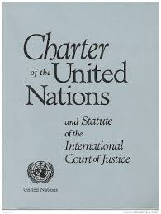
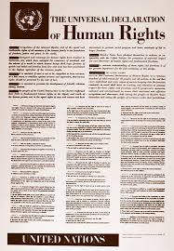
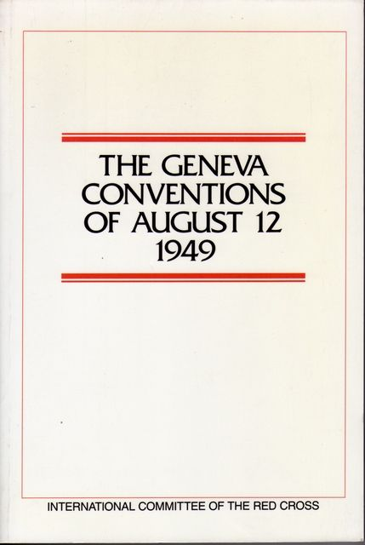
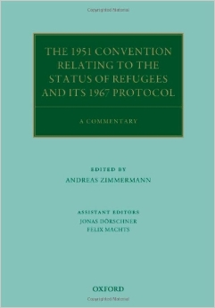
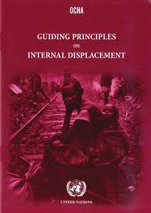
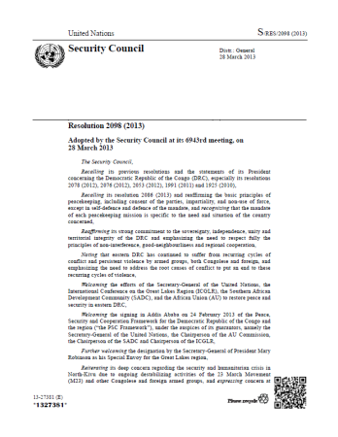
2. Legal Framework for UN
Peacekeeping Operations
UN Core Pre-Deployment Training Materials 2017

Slide 8
3. UN Charter
Chapters Indicating Peacekeeping
Chapter I: Purpose of UN “…to maintain international peace and security”
Chapter V: Security Council “…primary responsibility for international peace and security...”
Chapter VI: Outlines range of peaceful measures
Chapter VII: “Security Council...may take action as may be necessary...”
Chapter VIII: Involvement of
regional partners in maintaining
international peace and security
UN Core Pre-Deployment Training Materials 2017

Slide 9
Learning Activity
1.4.2
International Human Rights Law
Instructions:
What are “human rights”?
Give examples
List examples of international human rights law
Time: 5 minutes
Brainstorming: 3 minutes
Discussion: 2 minutes
UN Core Pre-Deployment Training Materials 2017

Slide 10
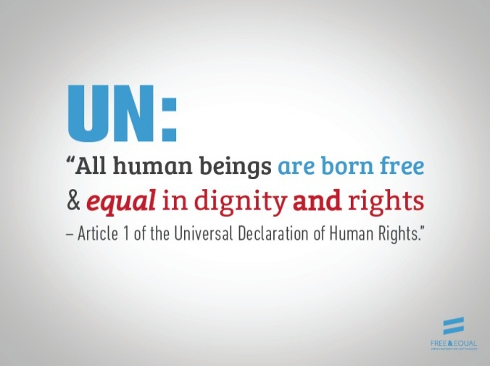
4. International Human Rights Law
What are Human Rights?
“Human rights” are rights inherent to all human beings, whatever our nationality, place of residence, sex, sexual orientation and gender identity, national or ethnic origin, colour, religion, language or any other status
We are all equally entitled to our human rights without discrimination
UN Core Pre-Deployment Training Materials 2017

Slide 11
Examples of Human Rights
Examples of civil and political rights include the right to:
Life
Freedom from torture
Protection from discrimination
Freedom of expression
A fair trial
Not be held in slavery
UN Core Pre-Deployment Training Materials 2017

Slide 12
Examples of Human Rights
Examples of economic, social and cultural rights include the right to:
Join a trade union
Education
Food
Housing and medical care
Social security and work
Equal pay for equal work
UN Core Pre-Deployment Training Materials 2017

Slide 13
What is International Human Rights Law?
International Law protecting fundamental human rights of every individual at all times
Applies both in war and peace, to all human beings
UN Core Pre-Deployment Training Materials 2017

Slide 14
Legal Sources
UN Charter
Universal Declaration of Human Rights
Covenant on Economic,
Social and Cultural Rights
Covenant on Civil
and Political Rights
(also referred to as International Bill of Human Rights)
Focus areas of specialized human rights treaties
Genocide
Refugees
Torture
Racial Discrimination
Disabilities
Children’s Rights
Trafficking
Disappearances
Discrimination Against Women
UN Core Pre-Deployment Training Materials 2017

Slide 15
5. International Humanitarian Law
What is International Humanitarian Law?
“Law of war” or “law of armed conflict”
Applies in times of armed conflict
Limits negative impact of armed conflict and reduces suffering during war
Individuals are protected under IHL if they do not engage in hostilities, or are no
longer doing so
UN Core Pre-Deployment Training Materials 2017

Slide 16
Legal Sources
Geneva Conventions and Additional Protocols
Secretary-General’s Bulletin on IHL
UN Core Pre-Deployment Training Materials 2017

Slide 17
Learning Activity
1.4.3
International Humanitarian Law – Who should be Protected?
Instructions:
Consider the images
Identify “civilians” and “combatants”
Who should be protected? Why?
Time: 5 minutes
Brainstorming: 3 minutes
Discussion: 2 minutes
UN Core Pre-Deployment Training Materials 2017

Slide 18
Essential Rules of IHL
Civilian targets cannot be attacked. Attacks only against military objectives.
Civilians and anyone no longer taking part in hostilities must be respected and treated humanely.
Anyone who surrenders or stops fighting (e.g., wounded) cannot be killed.
Torture is prohibited at all times and in all circumstances.
UN Core Pre-Deployment Training Materials 2017

Slide 19
Essential Rules of IHL (cont.)
Captured combatants and civilians must be respected and protected.
It is forbidden to use weapons or methods of warfare that are likely to cause excessive injury or unnecessary suffering.
Wounded and sick must be collected and cared for.
Medical personnel and medical establishments, transport and equipment must be respected and protected.
UN Core Pre-Deployment Training Materials 2017

Slide 20
Essential Rules of IHL (cont.)
The Red Cross, Red Crescent and Red Crystal emblems are signs of protection and must be respected.
Prevention and prosecution of war crimes covers attacking civilians, recruiting children as soldiers, torturing prisoners and sexual violence.
UN Core Pre-Deployment Training Materials 2017

Slide 21
Learning Activity
1.4.4
Use of Force at Home
Instructions:
Think about your home country
How is force applied legally at home?
Is there a difference with UN peacekeeping?
Time: 5 minutes
Brainstorming: 3 minutes
Discussion: 2 minutes
UN Core Pre-Deployment Training Materials 2017

Slide 22
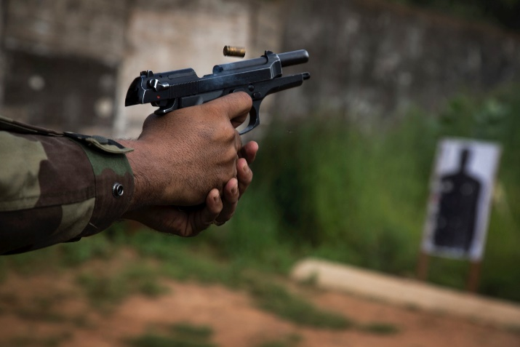
6. Rules of Engagement (ROE)
& Directive on Use of Force (DUF)
Guide use of force
ROE for military personnel, DUF for police personnel
Guidance in accordance with mandate, UN Charter, International Law
UN Core Pre-Deployment Training Materials 2017

Slide 23
The Importance
Use of force specific to mission and its mandate
Differs from national legal restrictions
Robust for volatile and potentially dangerous environments
UN Core Pre-Deployment Training Materials 2017

Slide 24
7. Additional Aspects of the Legal Framework
International Law – International Refugee Law, Guiding Principles on Internal Displacement, International Criminal Law
Security Council mandate
National law of host country
MOU between UN and T/PCCs
SOMA or SOFA
The Convention on the Privileges and Immunities of the UN of 1946
UN Internal Rules, Regulations and Guidance
UN Core Pre-Deployment Training Materials 2017

Slide 25
Summary of Key Messages
Legal framework includes International Law – UN Charter, IHRL, IHL
Human rights are universal – “civil and political rights”, “economic, social and cultural rights”
Individuals are protected under IHL if they do not engage in hostilities, or are no longer doing so
Know ROE, DUF – use of force is mission-specific, different from national legal restrictions, may be robust
UN Core Pre-Deployment Training Materials 2017

Slide 26
Questions
UN Core Pre-Deployment Training Materials 2017

Slide 27
Learning Activity
Learning Evaluation
UN Core Pre-Deployment Training Materials 2017

